Slide 1
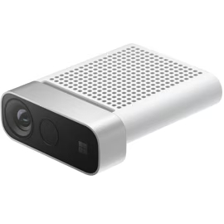
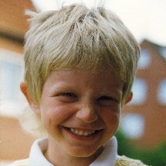



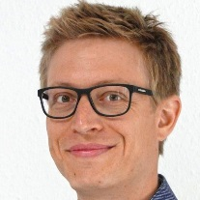

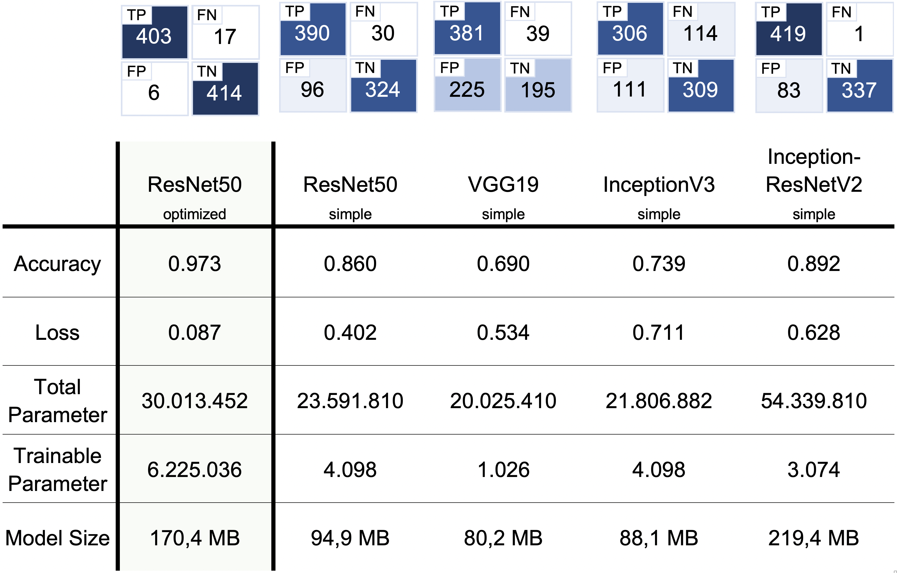
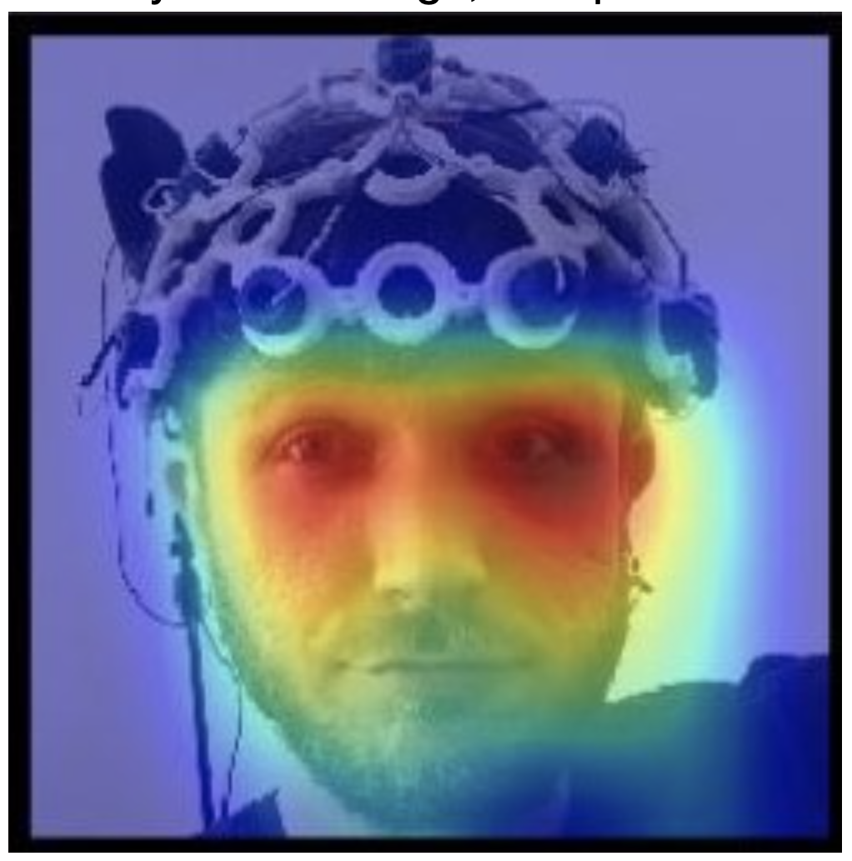
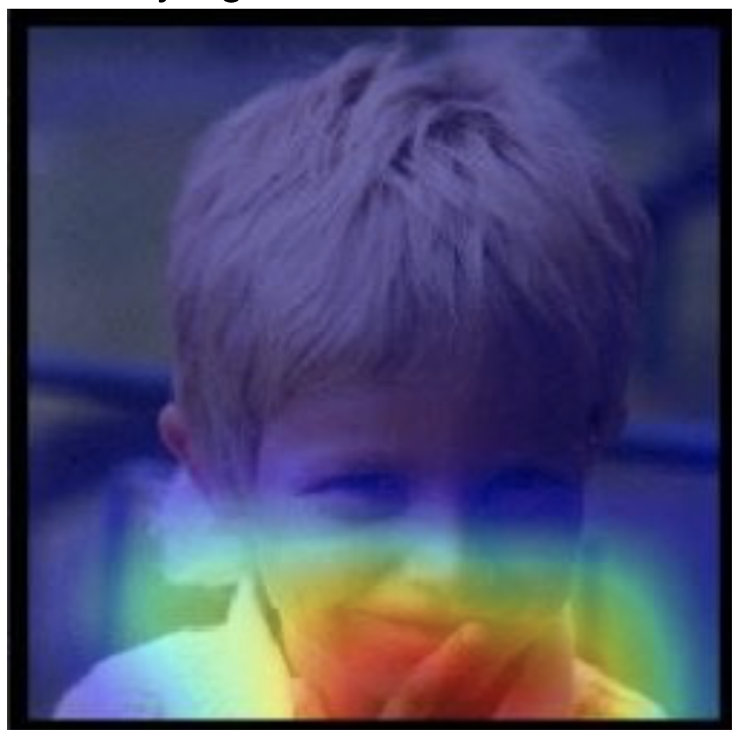
Grape berry detection using depth camera
Azure Kinect
Dominik Bücher
Automotive Systems Engineering, Heilbronn University of Applied Sciences
Overview
Dataset
Task:
Locate the individual grapes at a grape bunch by using a depth camera
Determination of the shape and color of the individual grapes
Training a neural network that can recognize the quality of the individual grape based on its shape and color
Approach:
Creating a point cloud of the grape using the Azure depth camera
Points with certain distances and colors are removed from the point cloud
The RANSAC algorithm is used to apply shape detection to the point cloud
Creation of a data set containing the shape and color of grapes with a good quality and with a bad quality
Training a neural network to determine grape quality based on shape and color
Training Data:
100 Selfies of the author’s face (different backgrounds and varying facial expressions) 50 Selfies of other peoples’ face 200 arbitrary Objects
Validation Dataset / Test Dataset:
19 / 14 Selfies of the author’s face. 10 / 7 Selfies of other peoples’ face 39 / 7 arbitrary Objects.
Data Augmentation:
30…52x more images due to augmentation
350 Training
Images
14.000 Training
Images
68 Validation
Images
3.500 Validation
Images
28
Testing
Images
840
Testing
Images
image augmentation
Neural Network Description
Exemplary Results on Unseen Test Data
Analyzed Network Architectures (Base Network):
VGG19 [3]
InceptionV3 [4]
InceptionResNetV2 [5]
ResNet50 [6]
Activation function for all networks: ReLU
Simple Transfer-Learning Architecture for Performance Evaluation:
Optimized Transfer-Learning Architecture for the “winner”:
Legend:
Correctly classified “user” (TP)
Correctly classified “no user” (TN)
XX.X %: Confidence
– (c): User at different age. Note: Training with adult images only.
(d) – (e): Brother of the user
(f): Other object (with face)
(a) 99.9 %
(b) 99.8 %
(c) 100 %
Base Network
Global Average
Pooling 2D
Dense
(2, Softmax)
(d) 91.2 %
(e) 99.9 %
(f) 99.8 %
ResNet50
Dense
(60, ReLU)
Flatten
BatchNorm
Dropout
Dense (50, ReLU)
Dense
(2, Softmax)
Dropout
Performance Evaluation
Attention Maps – Hypotheses for Interpretation
Approach: Replace the last softmax activation layer of the network with a linear activation layer and depict result as an overlay in form of a heatmap
Ideal case:
The network focuses on the eyes
Eye-Area is known as well suited for identification of faces
BCI-Cap is ignored by the network – it was not present in the training data
Non-ideal case:
Network focuses on the hand at the mouth instead of the eyes.
Pose was available in the training data
Can hint at overfitting
Conclusion
References
Optimized approach for user identification with 97,3 % accuracy
Requires only 100 individual training images of the user
Robustness:
Distinguishes close family members with high confidence in classification
Identifies user also at different age although data was not present during training
Well-balanced confusion matrix: Slight trend to reject real user instead of wrongly classifying others as user
Inference time: 35 ms, using GPU, image size: 224x224 pixels
[1] S. Fahad, S. ur Rahman, I. Khan and S. Haq, “An experimental evaluation of different face recognition algorithms using closed circuit Television images,” 2017 IEEE 2nd International Conference on Signal and Image Processing (ICSIP), Singapore, 2017, pp. 51-54.
[2] J. Deng, W. Dong, R. Socher, L. Li, Kai Li and Li Fei-Fei, “ImageNet: A large-scale hierarchical image database,” 2009 IEEE Conference on Computer Vision and Pattern Recognition, Miami, FL, 2009, pp. 248-255.
[3] Karen Simonyan, Andrew Zisserman, “Very Deep Convolutional Networks for Large-Scale Image Recognition”, arXiv:1409.1556.
[4] Christian Szegedy, Vincent Vanhoucke, Sergey Ioffe, Jonathon Shlens, Zbigniew Wojna, “Rethinking the Inception Architecture for Computer Vision”, arXiv:1512.00567.
[5] Christian Szegedy, Sergey Ioffe, Vincent Vanhoucke, Alex Alemi, “Inception-v4, Inception-ResNet and the Impact of Residual Connections on Learning” arXiv:1602.07261.
[6] Kaiming He, Xiangyu Zhang, Shaoqing Ren, Jian Sun, “Deep Residual Learning for Image Recognition”, arXiv:1512.03385.
dbuecher@hs-heilbronn.de

